Slide 1
Essential Tools and Tips for Proactive Property Management
A guide by Chris Johnson
Presented by Timothy Wehner

Slide 2
About Me
Richmond, VA
VP, Dodson Property Management
Regional VP for Pacific/Pacific Islands
Randolph-Macon College
Golf Coach
BBQ Adorer

Slide 3
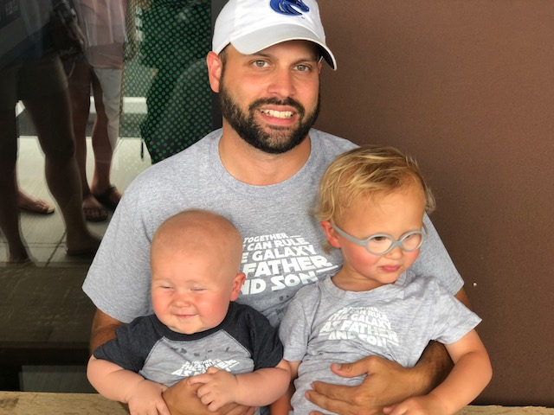
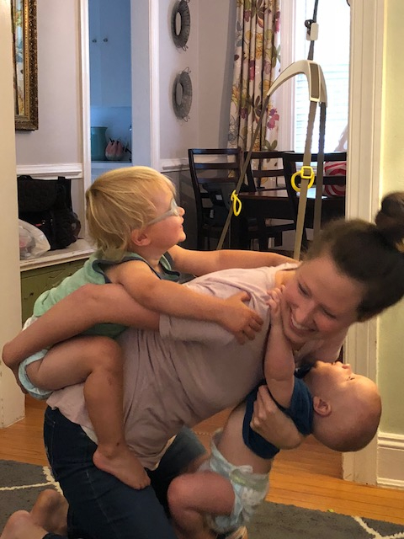
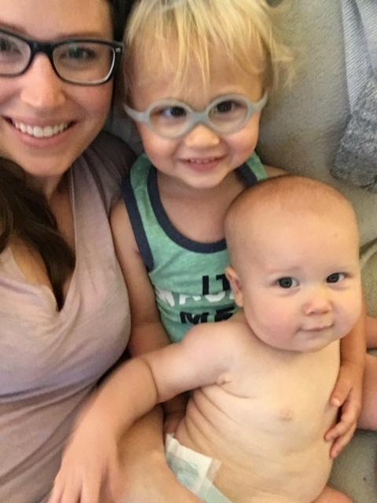
About Me

Slide 4
Purpose
The purpose of this class is to help managers and owners eliminate the reactive mindset that goes hand in hand with Property Management. This mindset will leave you scrambling for answers, running around aimlessly, and quickly overwhelmed with work…….what a waste of time!
Whether you have a portfolio of 10 properties or 300, your ability to create an experience where each owner and tenant feel like they are your number 1 priority will determine your success as a manager. This is accomplished by turning your reactive mindset into a proactive one, by advising your customers/clients, and being “ahead of the game”

Slide 5
The
Three Pillars
of Proactive Management
ORGANIZATION COMMUNICATION TECHNOLOGY

Slide 6
Organization
“The coordination of your administration”
Organization is one of the most important tools for being proactive with your management. Structure creates stability and consistency in your daily workflow and will free up more time for above and beyond service. The backbone of organization revolves around two key tools that every manager uses on a daily basis - your calendar and email.

Slide 7
Calendar Organization
Time Blocks
Daily
Weekly
Bi-Weekly
Monthly
Showings
Renewals
Inspections
Admin Work
2) Accountability
Stick to your Calendar
Start and stop on time
Focus on the task at hand
Don’t get sidetracked
No more rescheduling

Slide 8
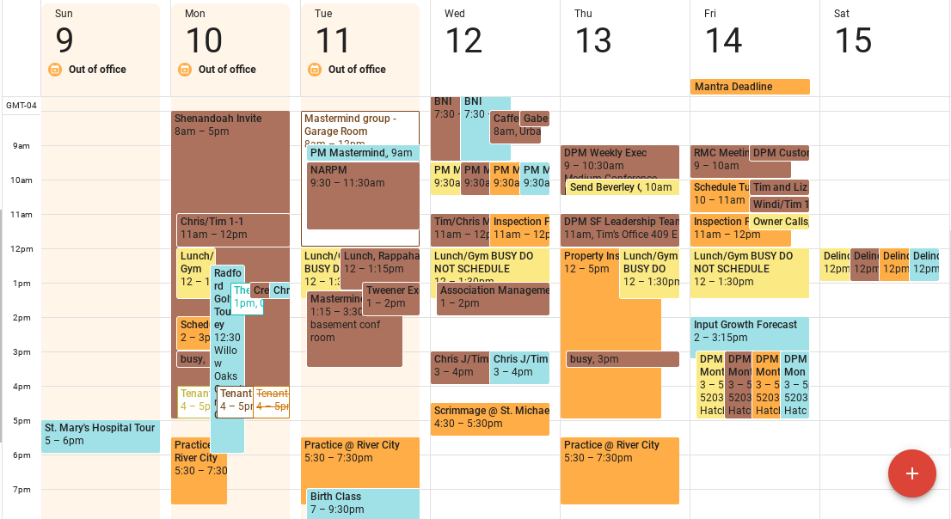
This is a weekly snapshot of my team’s calendar (context into 3 person team)

Slide 9
What the untrained eye sees
What the trained eye sees is:
An owner follow up call
A move out inspection
Timely payment to our vendors
A company meeting to improve processes
My haircut appointment
Met Deadlines
Happy Tenants
Satisfied Owners
(Photo credit to critically acclaimed 1999 science fiction action film written and directed by The Wachowski Brothers and starring Keanu Reeves, The Matrix)

Slide 10
Email Organization
Tool vs Pool Mentality
Tool - Something you implement to carry out a specific function
Set up Sub Folders
Properties, Major Owner Groups, key figures in your company, yourself
Incoming emails are action items
Respond to the email and answer any question posed. Move it out your inbox.
Respond to initial email, then delegate action either to a subordinate, tenant, vendor, or owner. After that, set a reminder on your calendar to follow up. Move it out your inbox.
Set a reminder on your calendar for future action (ex. A trip to a property or appointment with client). Move it out your inbox.

Slide 11
Pool - Something that gets filled up with your emails, and you quickly drown.
Things to avoid:
Stars
Flags
Multiple Pages of Emails
Unread Emails
Emails without a response within the same day
This will make it difficult to prioritize emails, and ultimately you will have things fall through the cracks. With this method every incoming email is a priority that is responded to quickly which further aids your proactiveness.

Slide 12
Communication
“Conveying a message that strengthens your connections”
Communication could be the most important tool to ensure you are proactively managing your properties. When communication is poor, it serves as the biggest point of contention you will face with both owners and tenants.
Now that you are organized it is time to streamline your communication and develop a level of consistency that all will come to appreciate and expect moving forward.

Slide 13
Email Communication
Not all emails should just be a response to something coming into your inbox - that is not proactive at all. You will need to develop some consistent communication built around the key aspects of your management that you can use to initiate conversations. Putting together some canned responses to send will help initiate these conversations and provide clients and customers a sense that you are not just reacting to their emails as they come in. Some ideas for these are:
Proposals for Lease Renewals
Upcoming Inspection Notifications for tenants and owners
Move In Welcome Packets for tenants
Lease signing notifications for owners
Inspections follow up for owners
Delinquency updates for owners
Vacant unit updates for owners
Completion of maintenance notification for owners

Slide 14
Phone Communication
Your phone is an integral tool for ensuring your day to day efficiency. Making sure you are not tied to it all day allows you to concentrate on your calendared tasks and prompt responses to emails. Just because you are not attached at the hip does not mean it goes by the wayside, it just means it is being utilized properly.
Set up your voicemail, and allow for 12 business hrs to return any non emergency calls.
Set your calendar 15- 20 min to return non emergency voicemails at 12pm and 4pm each day.
Save all owner names and numbers in your phone. Always answer these calls.
If you get an email from an owner requesting a call, schedule a time and put it on the calendar. Do not just call right away.
Make sure your voicemail is giving and requesting the right information.

Slide 15
Technology
“The science behind the service”
Technology is a great tool for streamlining service and improving efficiency in regard to your property management. The ability to automate repetitive tasks and utilize vendors to improve your customer/client experience will ensure that you have the time to be proactive with your management.

Slide 16
Getting the most out of your technology-based vendors
Find vendors that can cut down your administrative tasks, such as:
Screening & qualifying tenants
Scheduling showings
Receiving maintenance requests
Execution of lease and renewal documents
Management software to house property information & reporting
It is important to be constantly assessing your vendors to make sure you are utilizing the full scope of their services, and providing them feedback about your user experience.

Slide 17
How do you use technology to proactively engage your customer?
Lease signing videos
“Good News” Videos
Calendly
Digital Owner and Tenant Handbooks

Slide 18
Questions?
Tim Wehner
Tim@DodsonProp.com
(804) 426-1660

